Slide 1
Chapter 7 – K-Nearest-Neighbor
Data Mining for Business Analytics in R
Shmueli, Bruce, Yahav, Patel & Lichtendahl

Slide 2
Characteristics of K-NN
Data-driven, not model-driven
Makes no assumptions about the data

Slide 3
Basic Idea
For a given record to be classified, identify nearby records
“Near” means records with similar predictor values X₁, X₂, … X_{p}
Classify the record as whatever the predominant class is among the nearby records (the “neighbors”)

Slide 4
How to measure “nearby”?
The most popular distance measure is Euclidean distance
Typically, predictor variables are first normalized (= standardized) to put them on comparable scales
Use preProcess() from caret package to normalize
Otherwise, metrics with large scales dominate

Slide 5
Choosing k
K is the number of nearby neighbors to be used to classify the new record
K=1 means use the single nearest record
K=5 means use the 5 nearest records
Typically choose that value of k which has lowest error rate in validation data

Slide 6
Low k vs. High k
Low values of k (1, 3, …) capture local structure in data (but also noise)
High values of k provide more smoothing, less noise, but may miss local structure
Note: the extreme case of k = n (i.e., the entire data set) is the same as the “naïve rule” (classify all records according to majority class)

Slide 7
Example: Riding Mowers
Data: 24 households classified as owning or not owning riding mowers
Predictors: Income, Lot Size

Slide 8
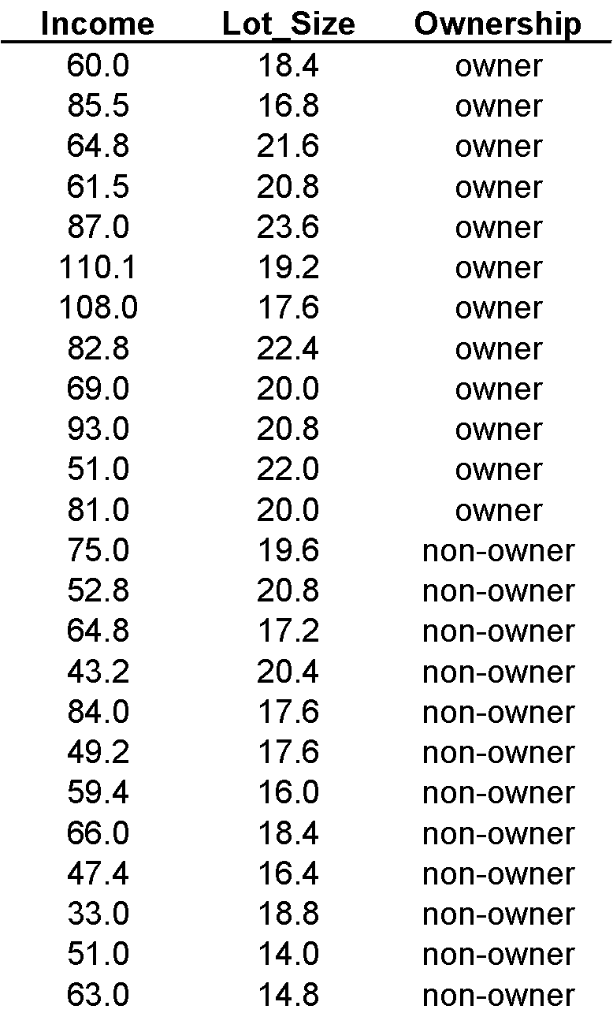

Slide 9
Finding nearest neighbors in R
Library FNN provides a list of neighbors
Library class allows numerical output
See Table 7.2 for code using knn from FNN library; compares each record from validation* set to k nearest records in training
*termed the test set in R

Slide 10
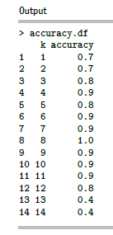
Finding nearest neighbors in R
Use library caret to get accuracy of different values of k, applied to validation data (see next slide for code)
When the most-accurate k is an even number (here it’s 8), it is possible for ties to occur in classifying new records. R breaks ties randomly.

Slide 11
KNN Code For Riding Mower Example
library(caret)
# initialize a data frame with two columns: k, and accuracy.
accuracy.df <- data.frame(k = seq(1, 14, 1), accuracy = rep(0, 14))
# compute knn for different k on validation.
for(i in 1:14) {
knn.pred <- knn(train.norm.df[, 1:2], valid.norm.df[, 1:2],
cl = train.norm.df[, 3], k = i)
accuracy.df[i, 2] <- confusionMatrix(knn.pred, valid.norm.df[,
3])$overall[1]
}

Slide 12
Using K-NN for Prediction (for Numerical Outcome)
Instead of “majority vote determines class” use average of response values
May be a weighted average, weight decreasing with distance

Slide 13
Advantages
Simple
No assumptions required about Normal distribution, etc.
Effective at capturing complex interactions among variables without having to define a statistical model

Slide 14
Shortcomings
Required size of training set increases exponentially with # of predictors, p
This is because expected distance to nearest neighbor increases with p (with large vector of predictors, all records end up “far away” from each other)
In a large training set, it takes a long time to find distances to all the neighbors and then identify the nearest one(s)
These constitute “curse of dimensionality”

Slide 15
Dealing with the Curse
Reduce dimension of predictors (e.g., with PCA)
Computational shortcuts that settle for “almost nearest neighbors”

Slide 16
Summary
Find distance between record-to-be-classified and all other records
Select k-nearest records
Classify it according to majority vote of nearest neighbors
Or, for prediction, take the as average of the nearest neighbors
“Curse of dimensionality” – need to limit # of predictors

